Slide 1

Digital Twin of CARR Lab
towards realization …

Slide 2
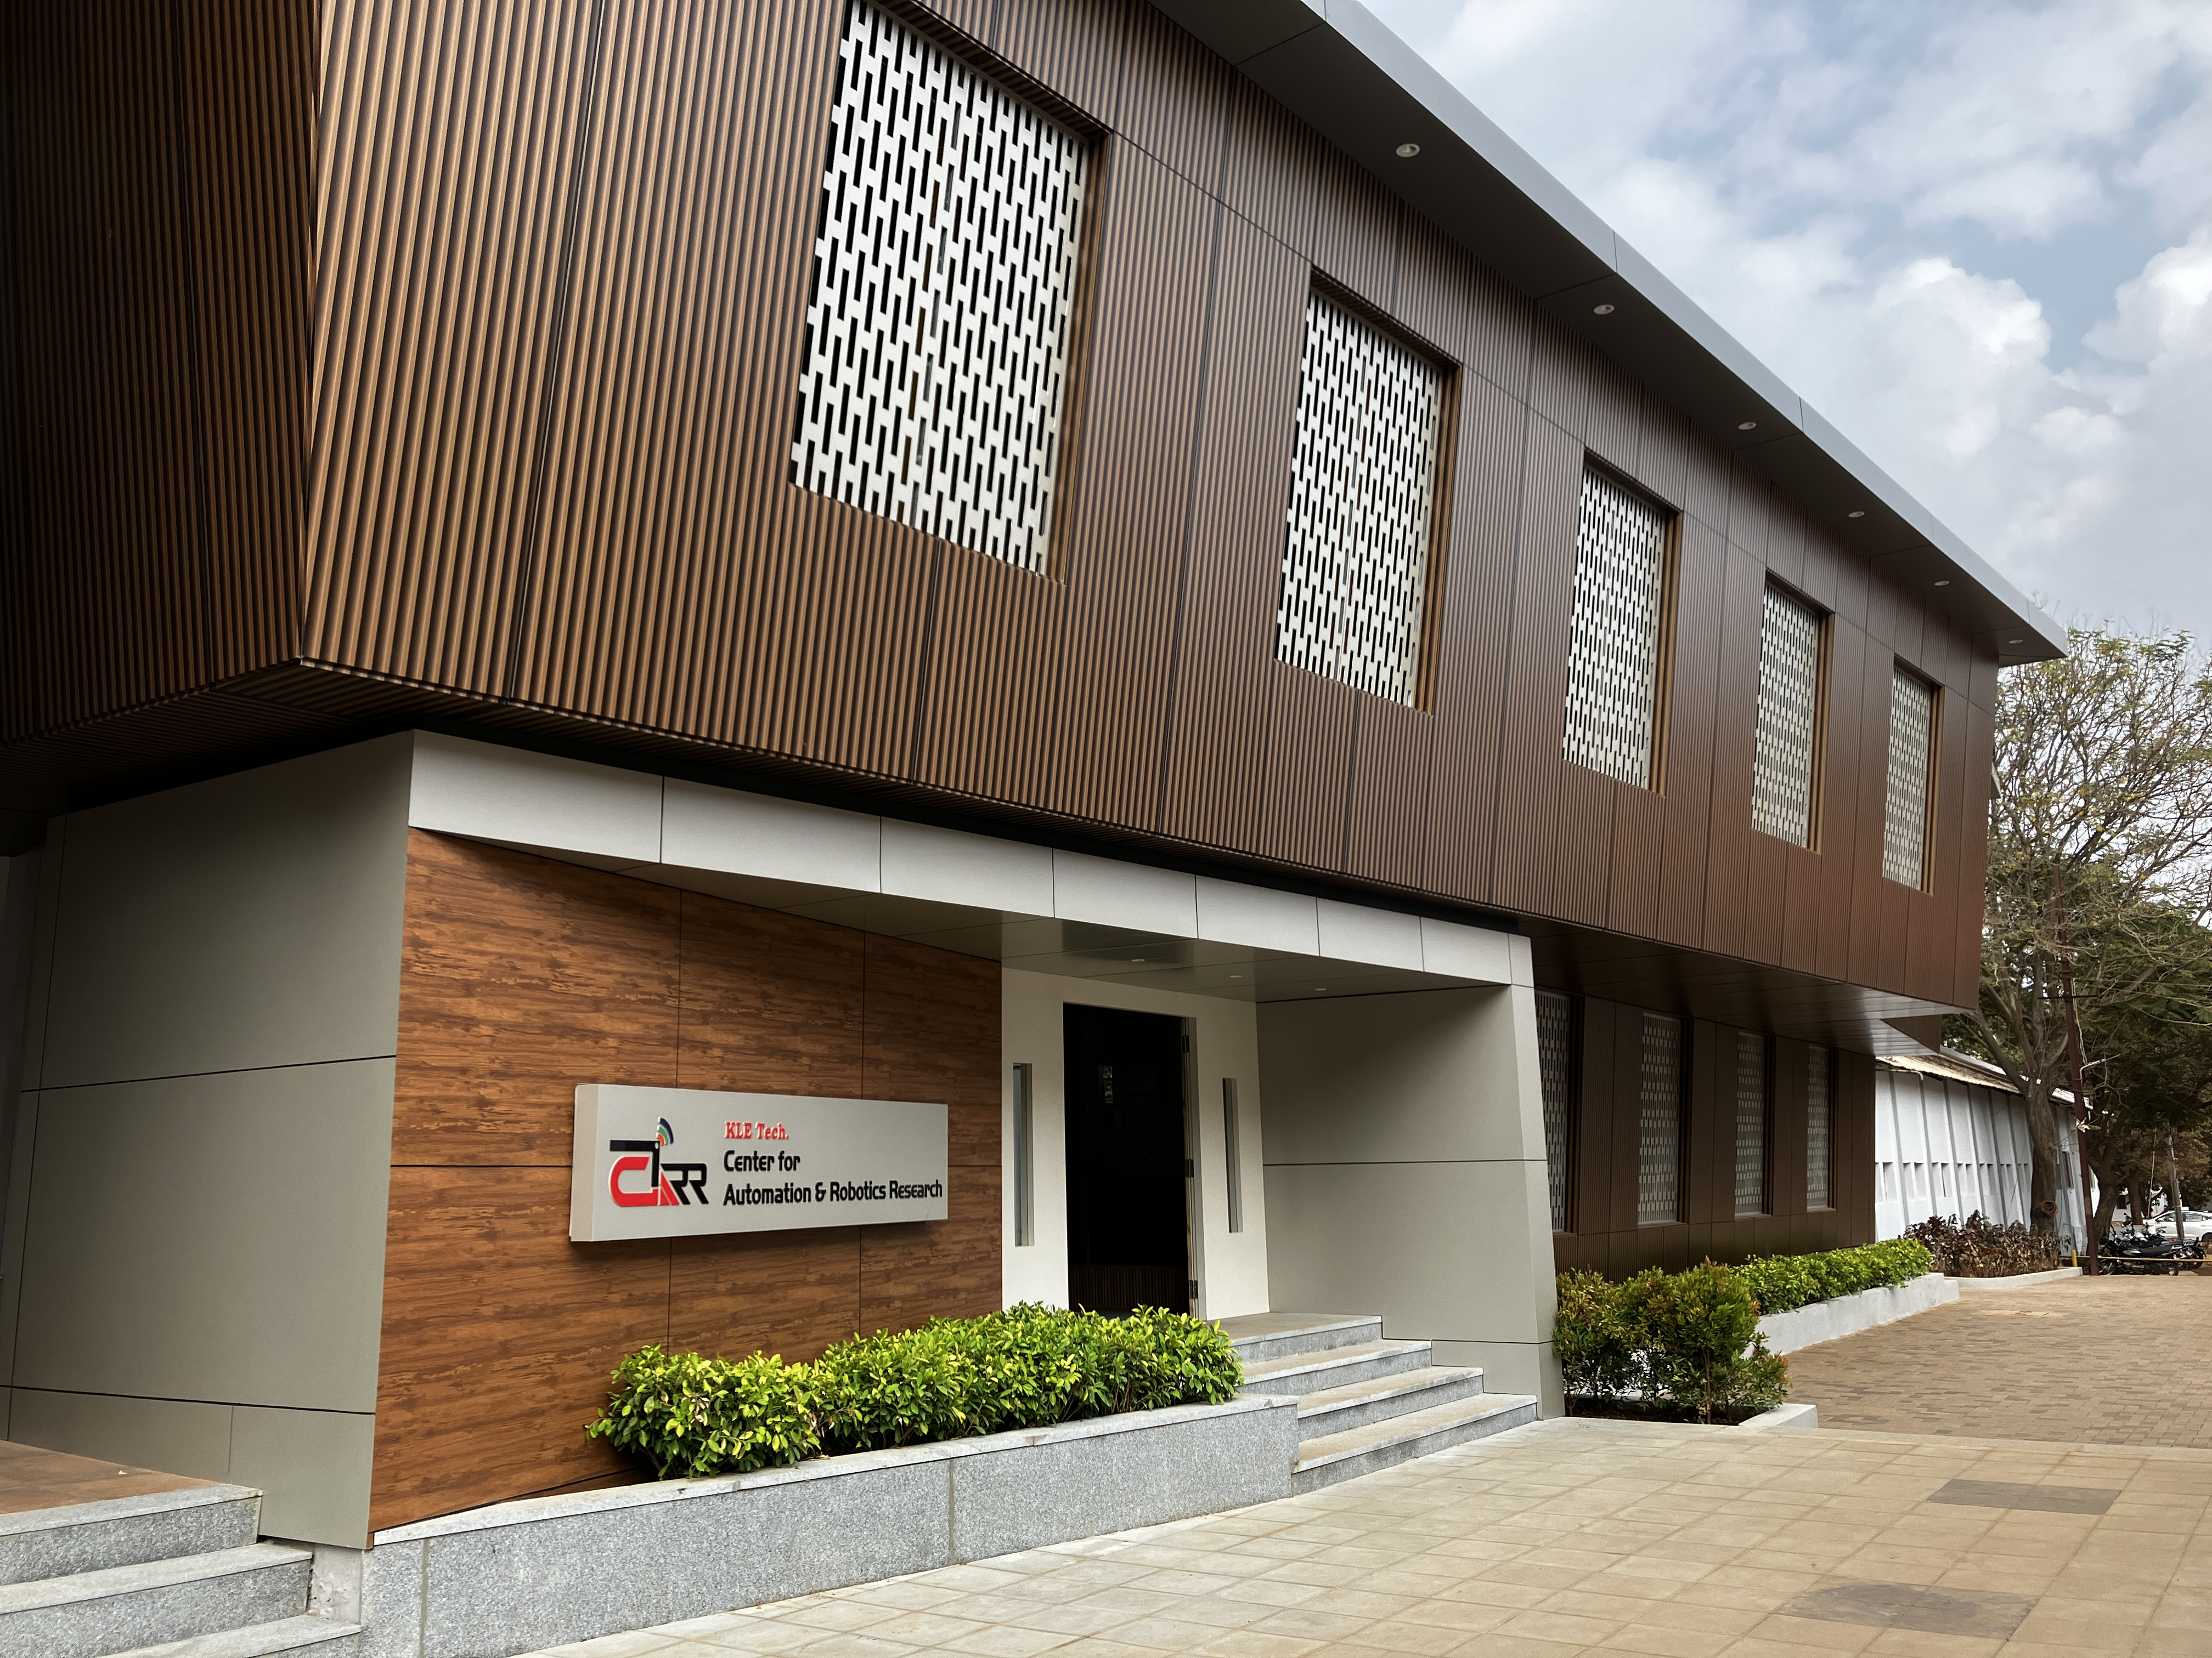
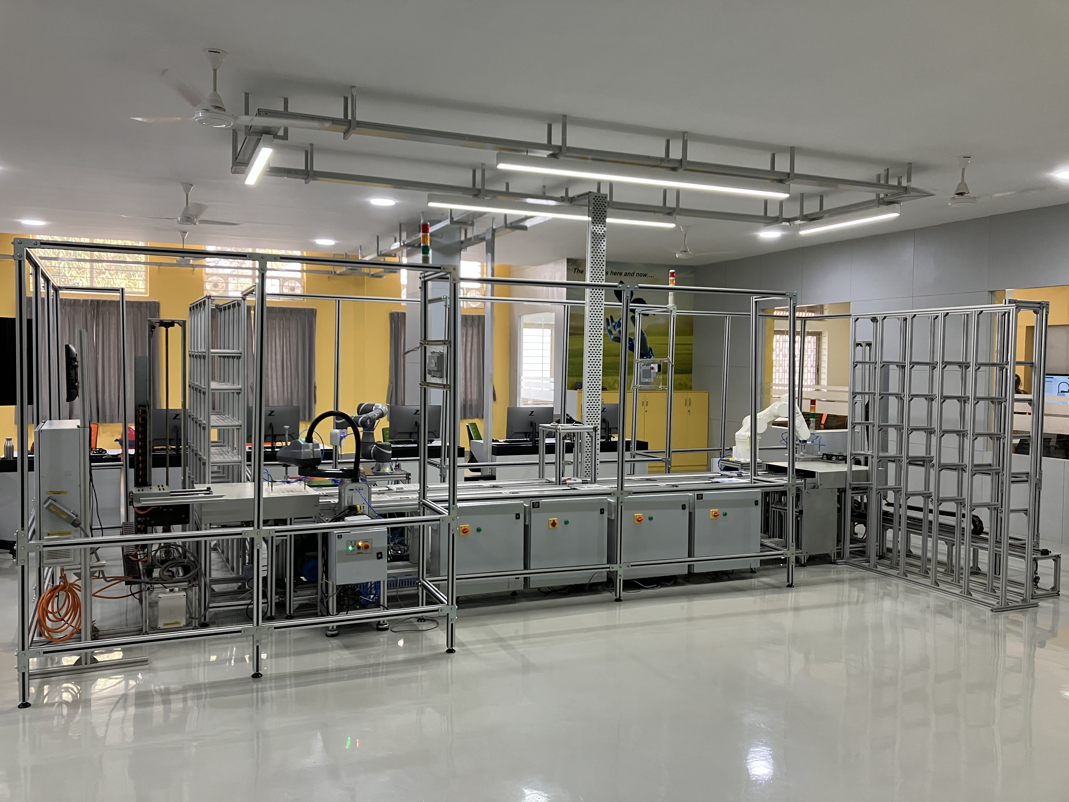
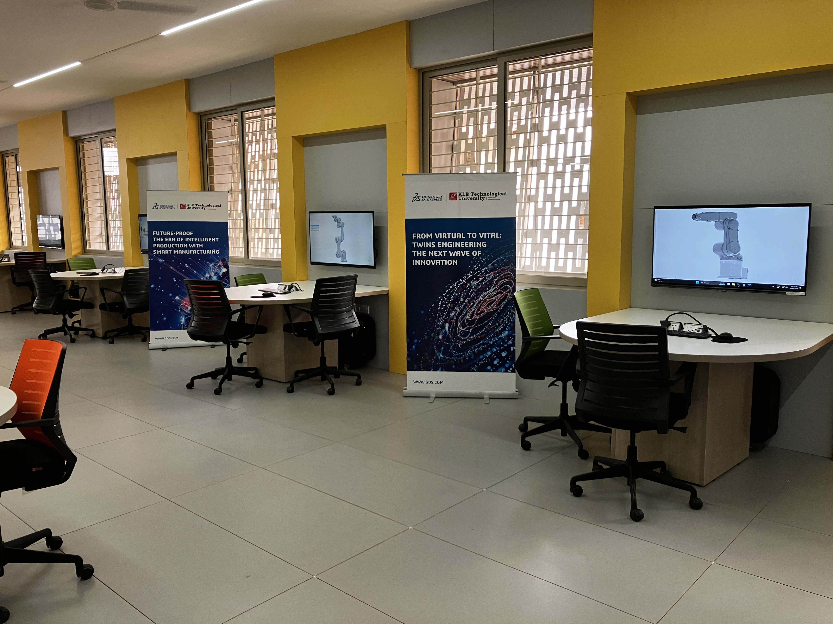
Infrastructure
Smart Manufacturing Lab
Modeling & Simulation Lab
2

Slide 3
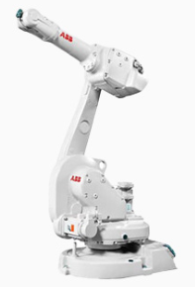

Smart Assembly Line - Setup
Robot #02
Vision System
Robot #03
ABB IRB 1600
»»
»»»»
»»»»
»»»»
»»
»»»»
»»»»
»»»»
RM ASRS
»»
FG ASRS
««
ABB IRB 1410
Robot #01
Dissassemble
Robot #04
»»
««
Scanner
Robot #01: i4-550L
Robot #02: TM 5-700 AC
Robot #03: Viper 650
Robot #04: LD-250 + TM 5-700 DC
Packing & Dispatching
3

Slide 4
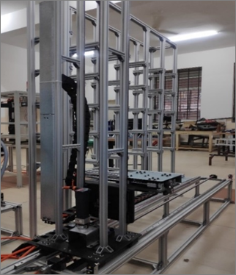
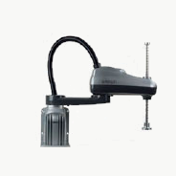
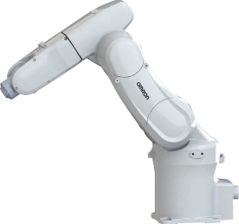
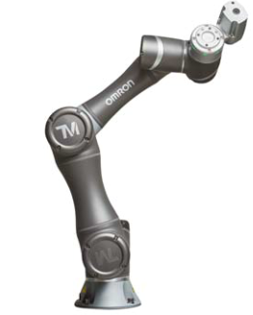
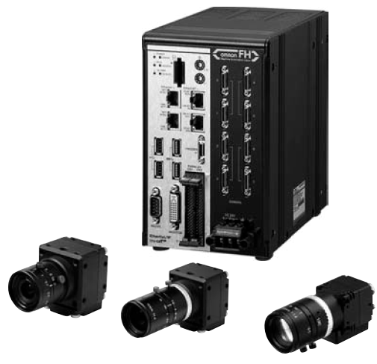
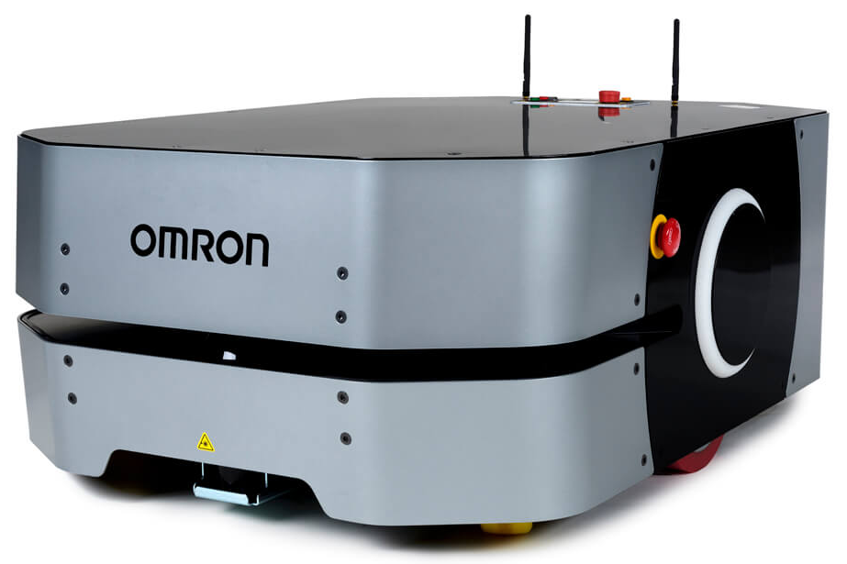
Smart Assembly Line - Setup
ASRS
2 Nos
SCARA
1 No
Articulated Arm
1 No
COBOT
2 Nos
Vision System
2 Nos
Beckhoff Industrial PC
Ultra Compact Control Cabinet IPC with Intel® Core™ i3-9100E, 3.1 GHz, 4 cores (C6030-0070)
OMRON PLCs
OMRON NJ-501-1520
OMRON NX-102-1220
OMRON NX-1P2
3DEXPERIENCE Software
CATIA
SIMULIA
DELMIA
BIOVIA
AMR
2 Nos
ABB
2 Nos
4

Slide 5
CARR Lab – Overview
Regulators / Certifiers / Standard Organizations
Initial Supplier
Second Tier Supplier
First Tier Supplier
Manufacturer
Warehousing
Distributors
Wholesalers
Retailers
...
Receive Order
Scheduling
Receiving
Putaway RM Warehouse
Material Picking
Operations
Storage FG Warehouse
Order Picking
Sorting, Packing & Palletization
Shipping & Invoicing
CARR Lab – Automation Setup Focus
Some of processes are not depicted to avoid confusion and complexity!
5

Slide 6
CARR Lab - Process
Procure-to-Pay (P2P) Process
Ordering of base plates and tiles
Receiving incoming base plats and tiles with quantity and quality checks
Ensure that each of these are uniquely identifiable to realize Unit–level Traceability
Store the base plate and tiles at given locations
Process in question can assist to realize Unit-Level Traceability
Requires multiple scanners next to stations
Define the ID string
6

Slide 7
CARR Lab - Process
Order-to-Cash (O2C) Process
Customer places orders (assuming MTO scenario)
Empty base plates are stored in RM ASRS
Tiles are loaded into tiles holders
Robot programs are selected based on order information
Robot #01 retrieves empty base plate
Robot #01 places empty base plate on empty pallet in front of it
Pallet and base plate moves to next station, i.e., Robot #02
7

Slide 8
CARR Lab - Process
Order-to-Cash (O2C) Process
Robot #02 places, if required, red, green and blue tiles
Pallet and base plate moves to vision system for quality inspection
Vision system inspects the base plate with tiles
Vision system determines if base plate with tiles is OK or NOK
Pallet and base plate moves to station next to Robot #03
Robot #03 will store OK base plate with tiles in FG ASRS in empty location
NOK base plate will be manually disassembled by operator and empty base plate will be stored in RM ASRS
8

Slide 9
CARR Lab - Process
Order-to-Cash (O2C) Process
Base plates with tiles will be retrieved from FG ASRS when the required quantity of them are produced against customer order
Retrieved base plates will stop at a station next to Packing and Dispatching
AMR with Cobots will move the base plate to the Packing and Dispatching station, where operator will pack and dispatch them to customers
Process in question can assist to realize Unit-Level Traceability
Requires multiple scanners next to stations
Define the ID string
9

Slide 10
Smart Manufacturing Framework - Overview
Extensive use of ML/AI algorithms to derive new insights
Deploy insights to control manufacturing & logistic processes
Smart Layer
Smart Products
Smart Supply Chain
Smart Maintenance
Big Data Analytics
Intelligent Machines
Augmented Reality
Advanced Function Layer
Event Stream Processing
Operator monitors and controls manufacturing & logistic processes
Autonomously trigger actions to predefined situations in near real-time
Production Management
Inventory Management
Quality Management
Maintenance Management
Basic Function Layer
Dashboard
Operational Metrics
Financial Metrics
ERP / PLM / PDM
Traceability assist to build the context
Operator monitors manufacturing & logistic processes manually
Reporting
Tracking & Traceability
Data Layer
Real-Time Process Data
Control Data
Data accessed from multiple sources and can be in multiple heterogeneous format
Edge Layer
Connectivity
Data Acquisition
Preprocessing
Support bi-direction communication, with basic error handling features
Resource Layer
Automation Systems (Sensors & Actuators)
Automation system supporting manufacturing & logistic processes
Process Layer
Manufacturing & logistic processes / operations / activities …
10

Slide 11
CARR Lab - Deliverables
Smart Layer
AI/ML Models – create, validate and deploy
Advanced Function Layer
Implement business logic related to production, inventory and quality management
Basic Function Layer
Various screens to display the status of processes
Definition of operational and financial metrics
Data Layer
UML Diagrams, ER Diagram, Data Flow Diagrams, SQL Scripts
Edge Layer
Programs to connect with resources through OPC UA, and maybe TCP/IP
Resource Layer
CAD Modeling, Simulations
PLC and Robot Programming
Process Layer
Cell Layout with required specifications
11

Slide 12
Thank You
12

